Slide 1

Introduction
Book Barter
CSE-5324-002-SFWR ENG I ANLY, DSGN, TESTING
Iteration 3
Team Name: The Fivers | Team Number: 12 11/27/23
Team Members
Niharika Dandu
Varad Nair
Srujan Chinta
Kushwanth Sai Bollepalli
Sreelakshmi Mopuri

Slide 2
Agenda
Project Description
Over All Design Approach
Requirements
Use Cases
Domain Diagram
Requirements to Use Case Traceability Matrix (RUCTM)
Increment Matrix (IM)
EUC & UIPs
Sequence Diagrams
Design Class Diagram
App Demo
Summary
Q/A

Slide 3
Project Description
Users register to establish a personalized reading identity, searching and browsing allows them to locate their next literary adventure
Messaging facilitates seamless communication and location services make in-person/local exchanges simple
Books Rating empowers readers to make informed choices, and safety & privacy features ensure secure interactions
Wishlist Management guarantees one will never miss a desired read
In short, "Book Barter" transforms book sharing into a hassle-free, enjoyable experience.

Slide 4
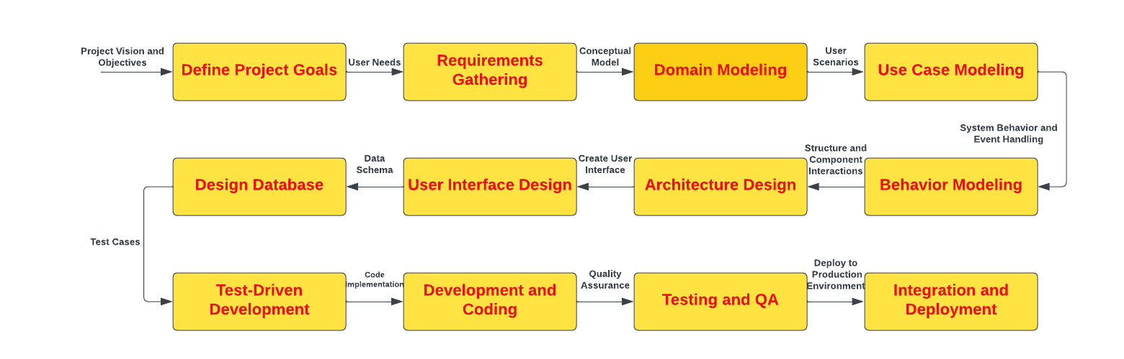
Over All Design Approach

Slide 5
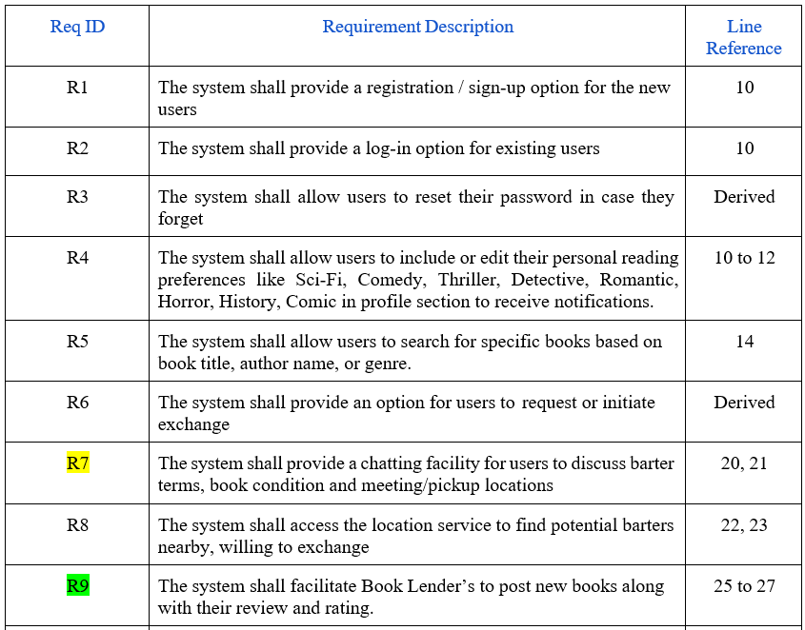
Requirements

Slide 6
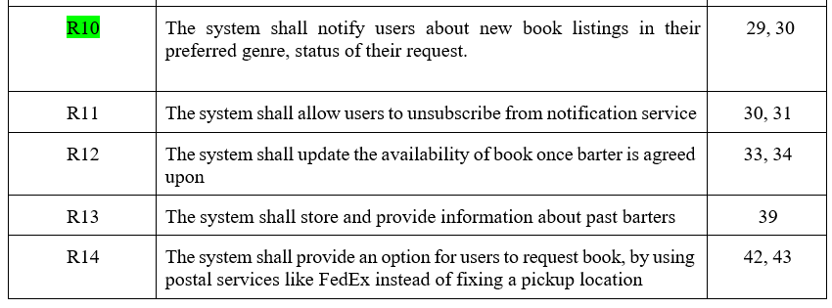
Requirements<<Continued>>

Slide 7
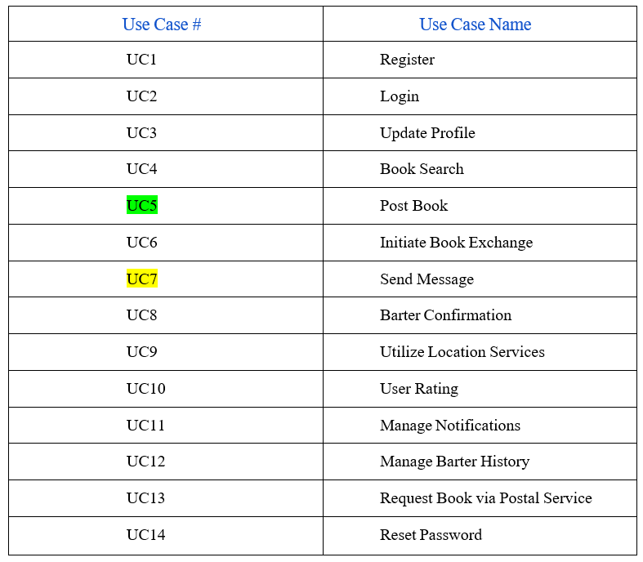
Use Cases

Slide 8
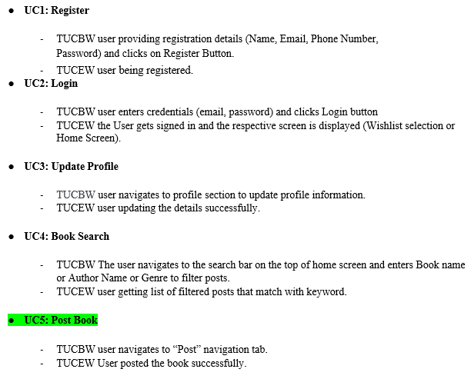
High level Use Cases

Slide 9
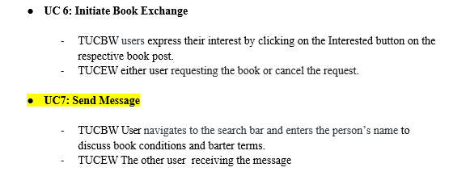
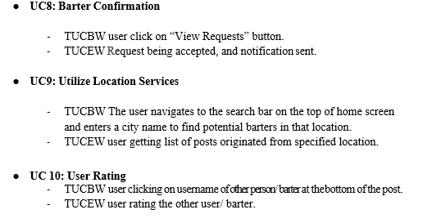
High level Use Cases<<Continued>>

Slide 10
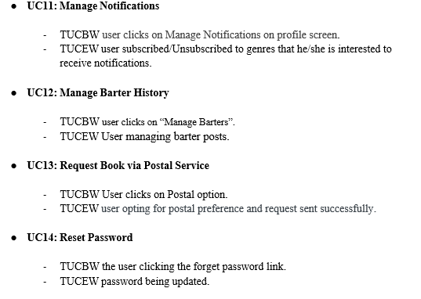
High level Use Cases<<Continued>>

Slide 11
Use Case Diagram

Slide 12
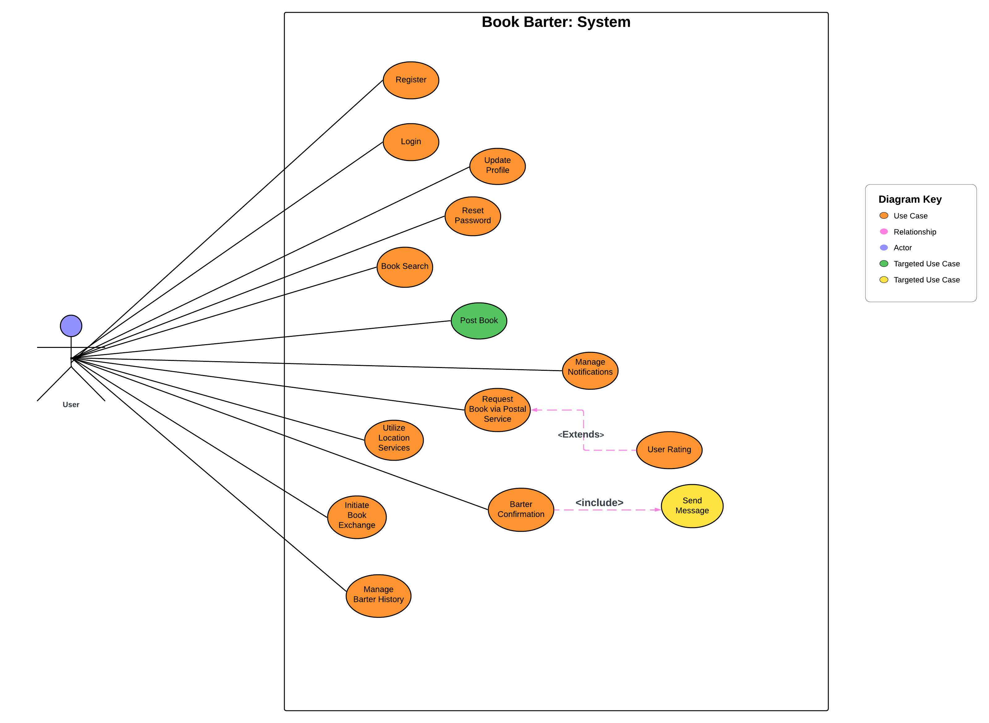

Slide 13
Domain Diagram

Slide 14
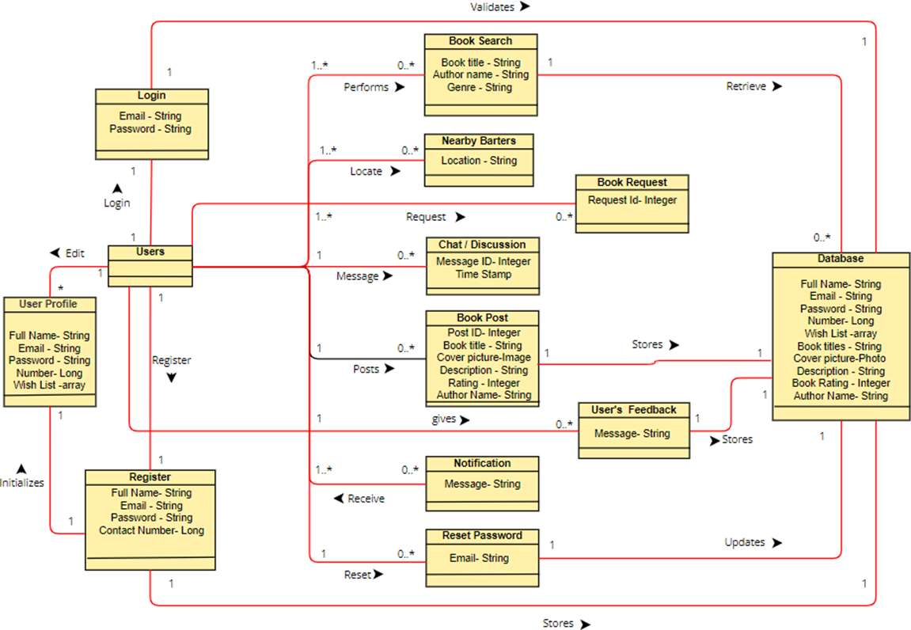

Slide 15
RUCTM

Slide 16
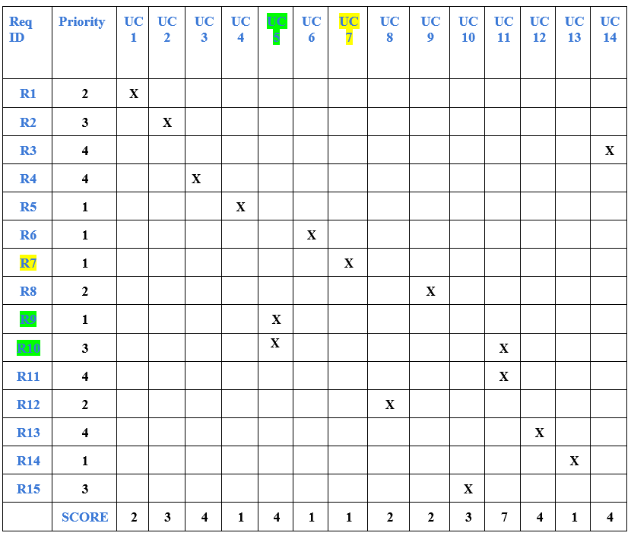

Slide 17
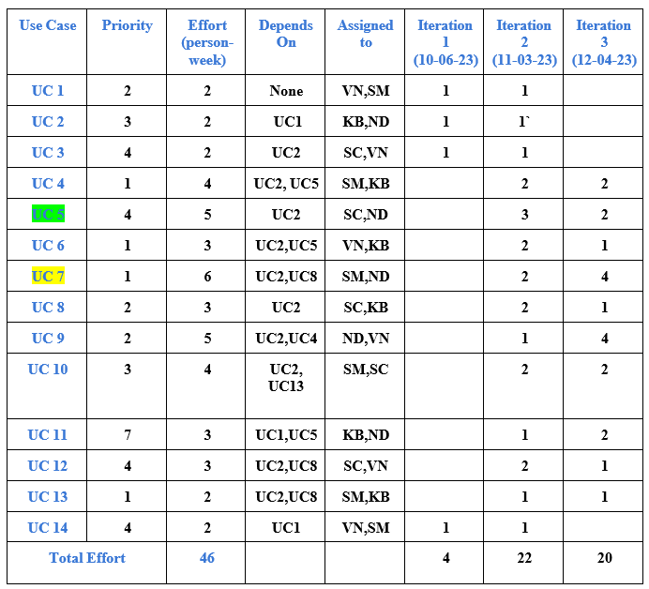
Increment Matrix
Team Members:
VN- Varad Nair
KB- Kushwanth Sai Bollepalli
SC- Srujan Chinta
ND- Niharika Dandu
SM- Sreelakshmi Mopuri
1 Person-Week = 5 hrs.

Slide 18
EUCs and UIPs

Slide 19
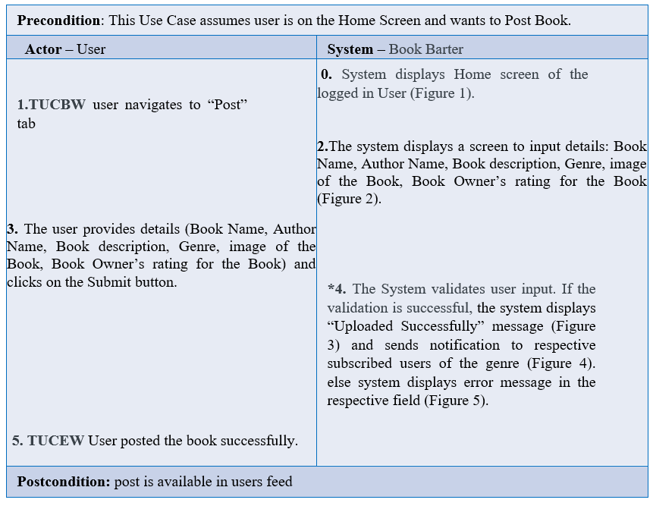
UC5: Post Book

Slide 20
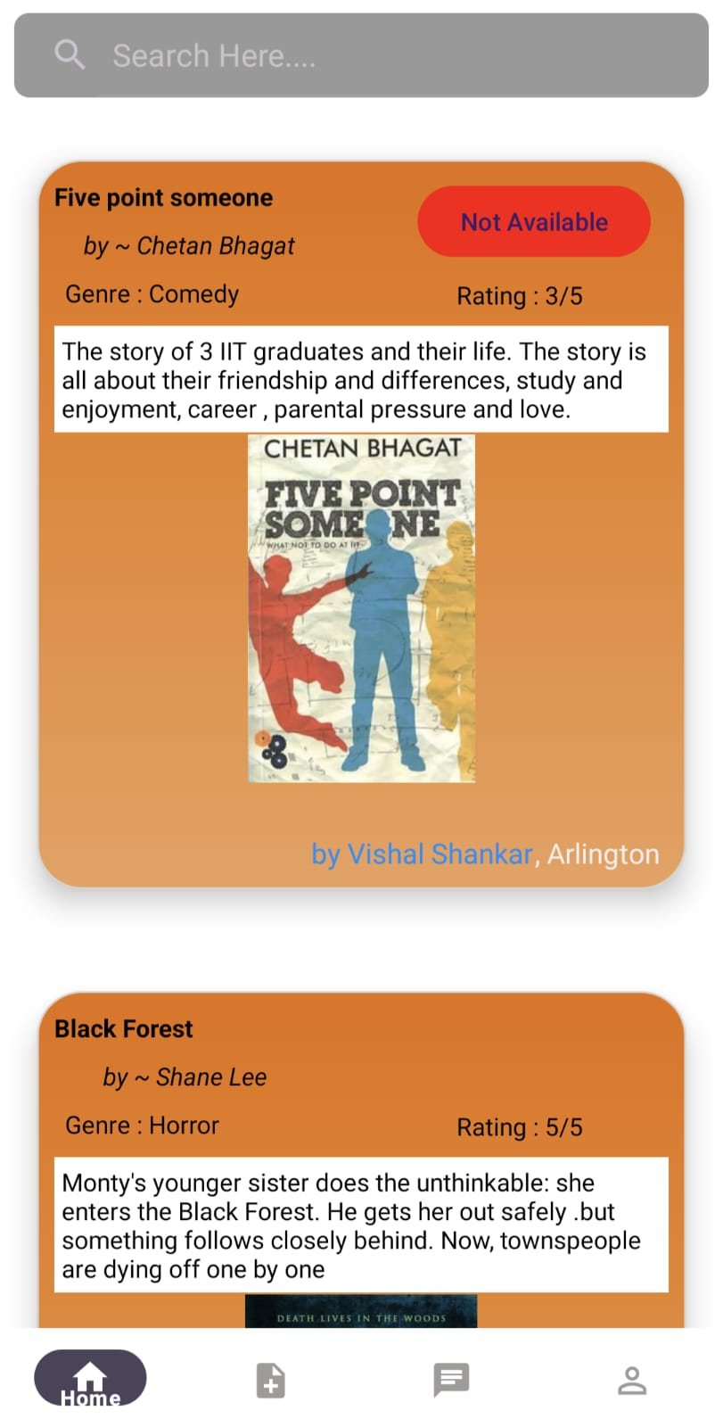
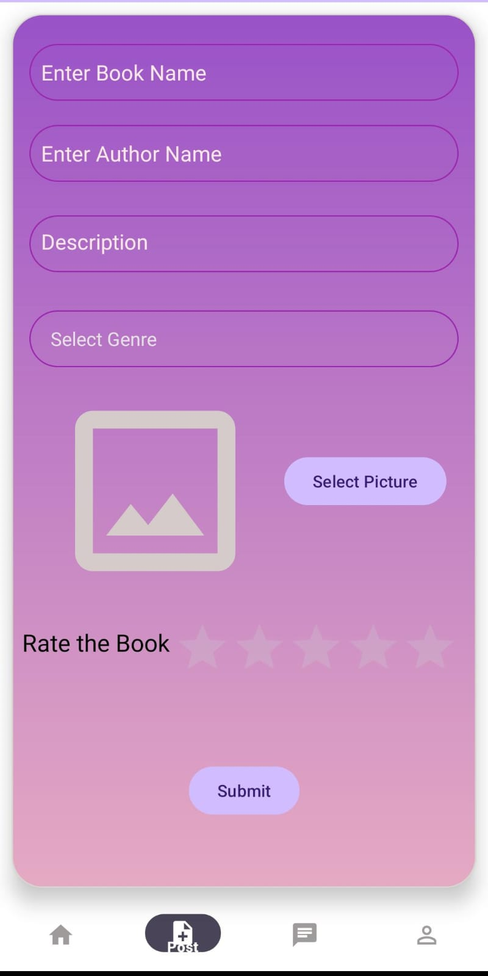
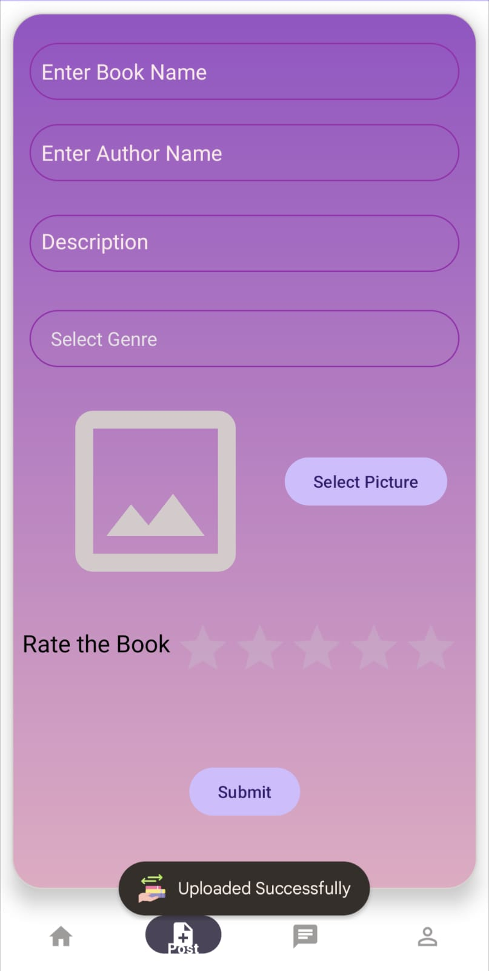
Fig. 1
Fig. 2
Fig. 3

Slide 21
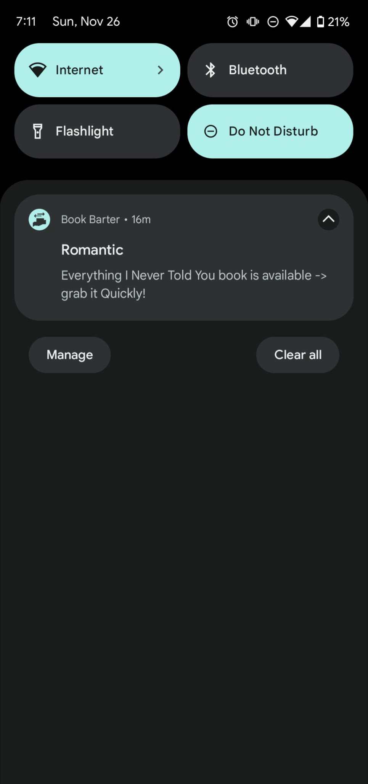
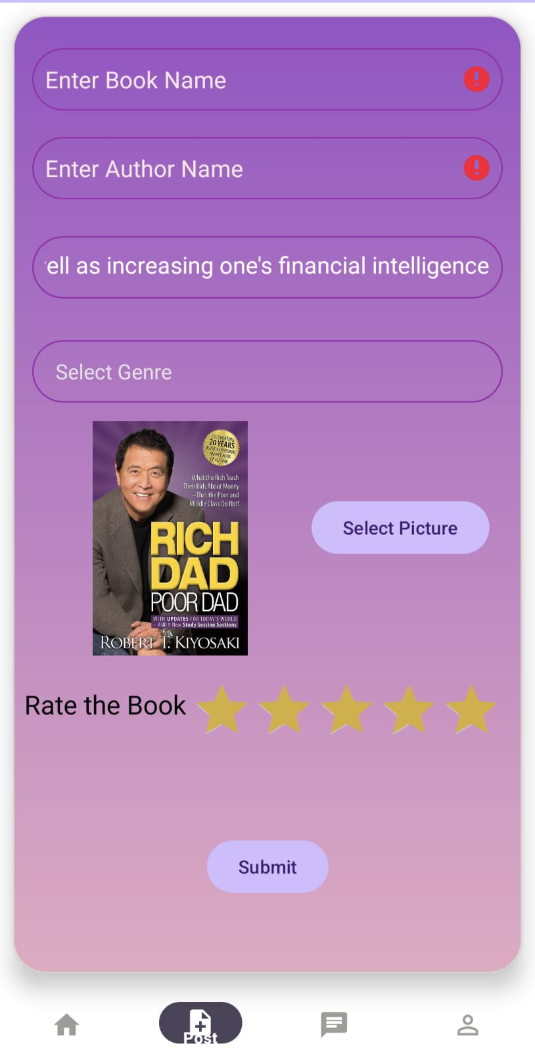
Fig. 4
Fig. 5

Slide 22
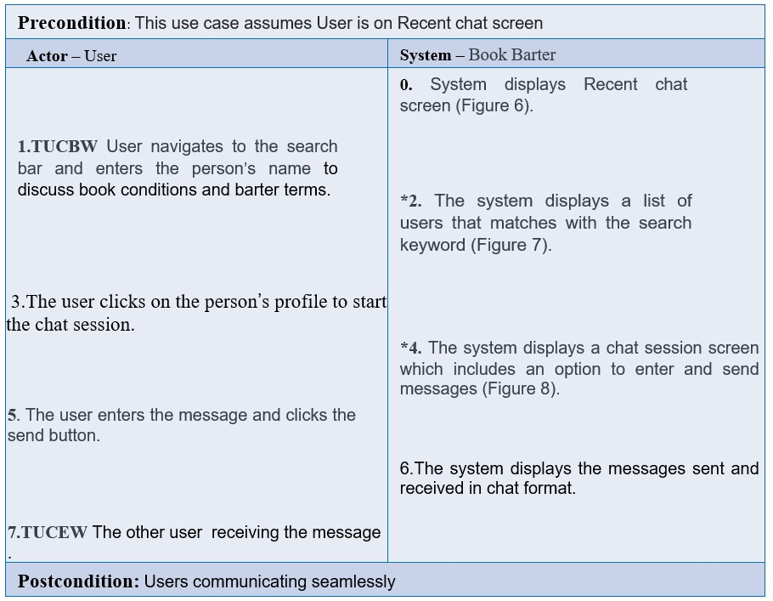
UC 7: Send Message

Slide 23
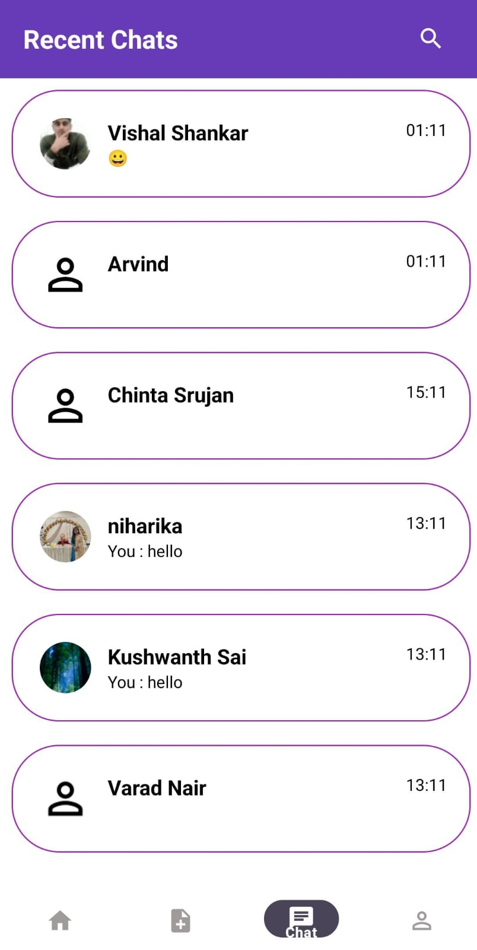
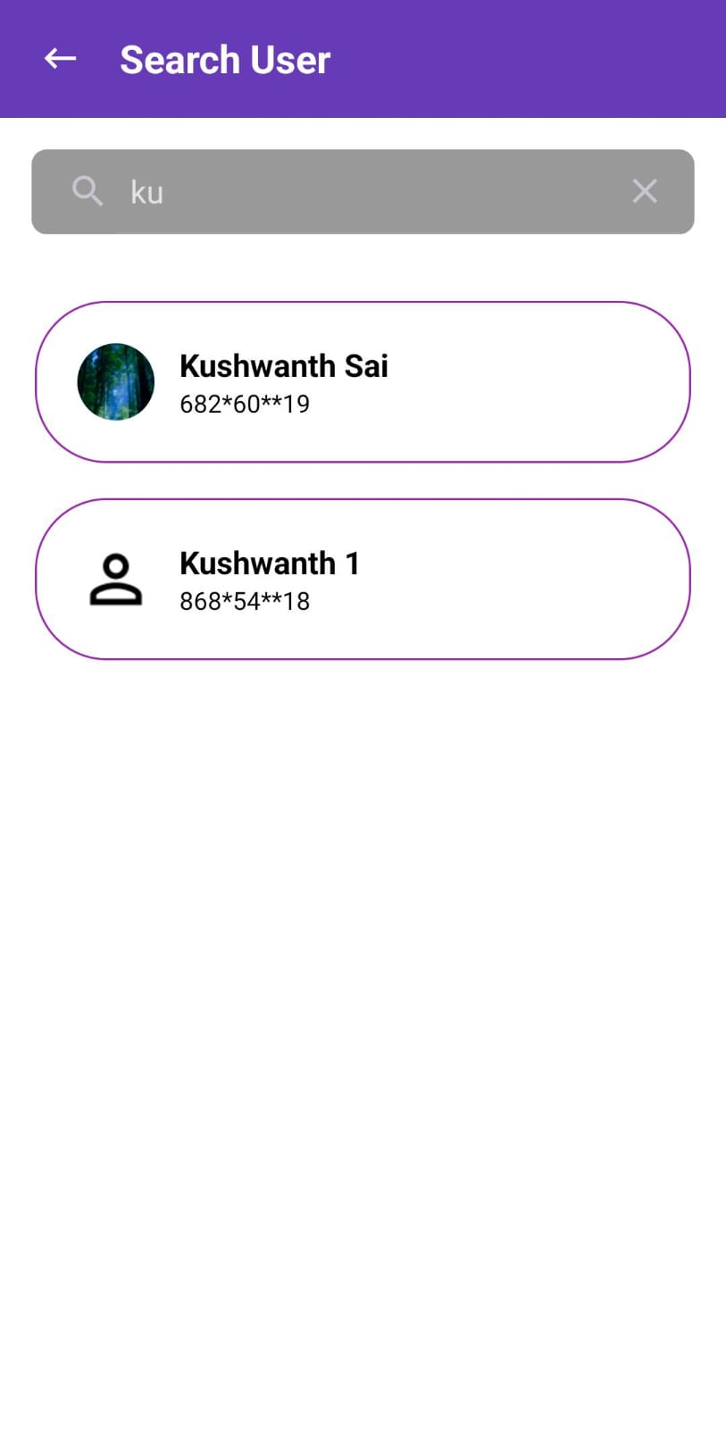
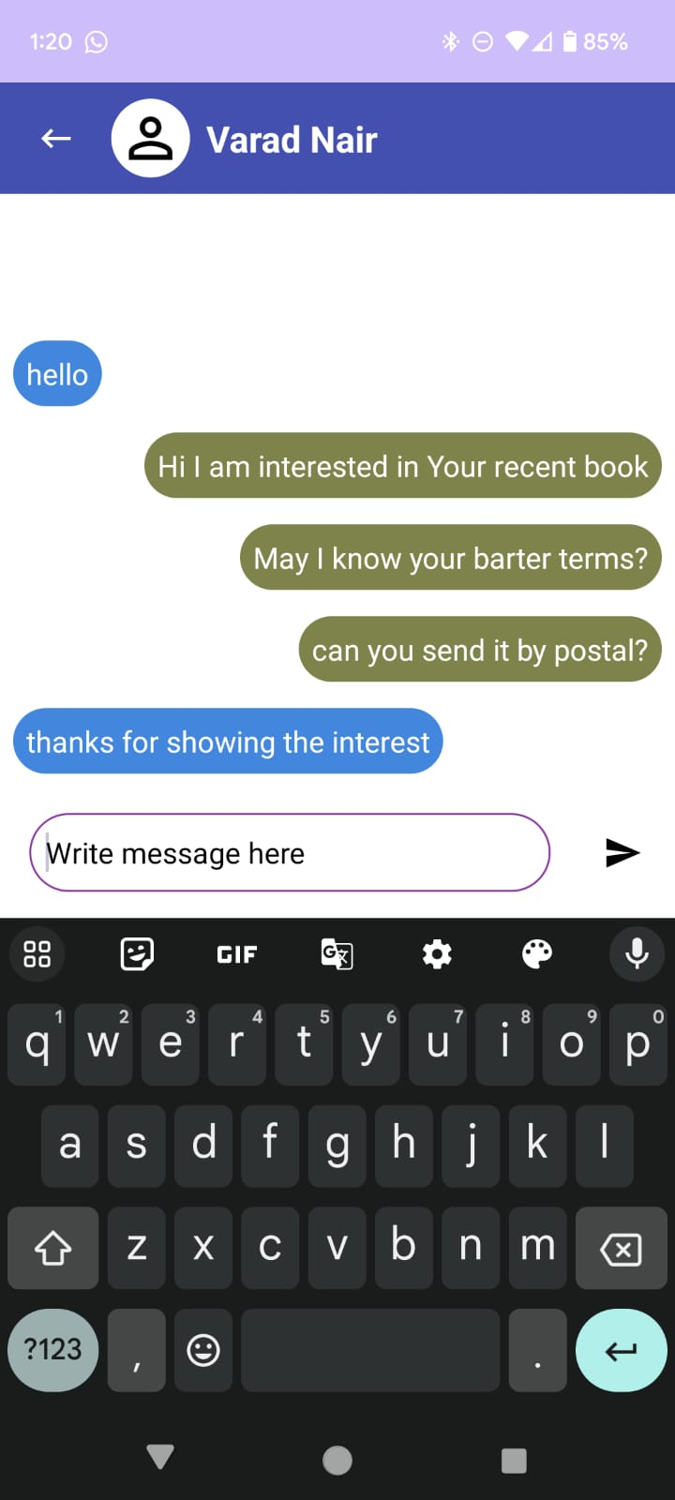
Fig. 6
Fig. 7
Fig. 8

Slide 24
Sequence Diagrams

Slide 25
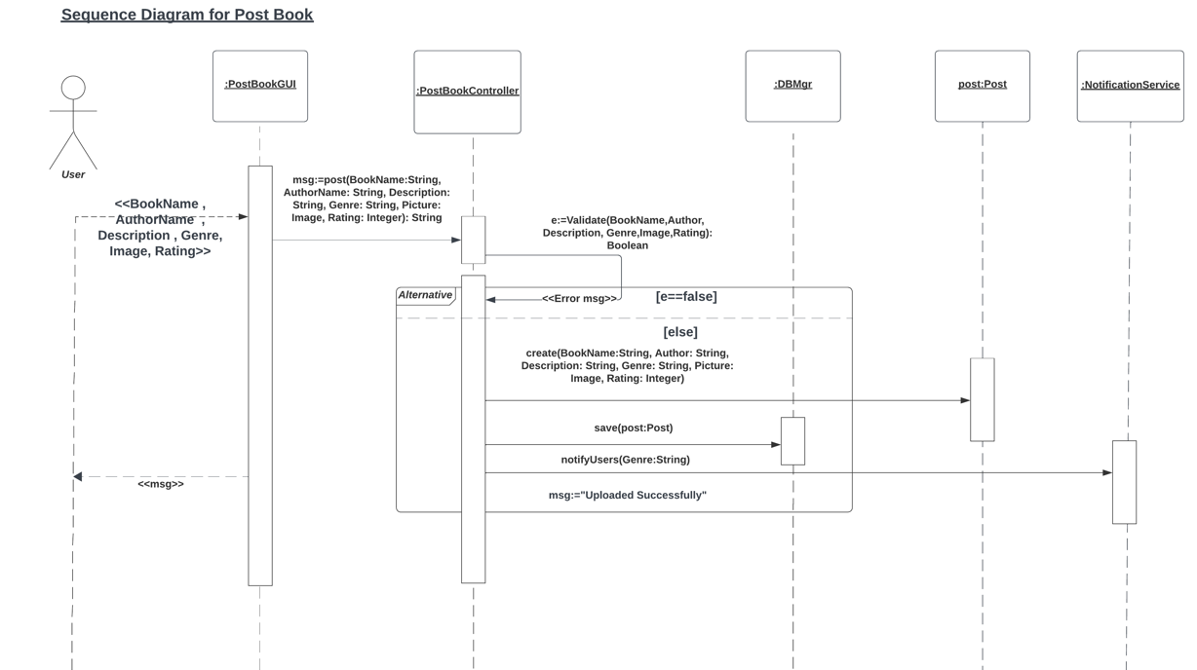

Slide 26
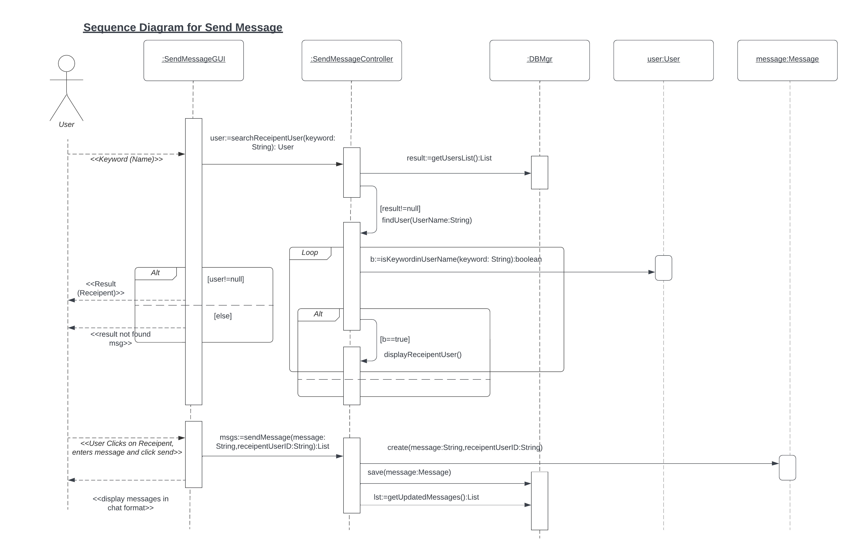

Slide 27
Design Class Diagram

Slide 28
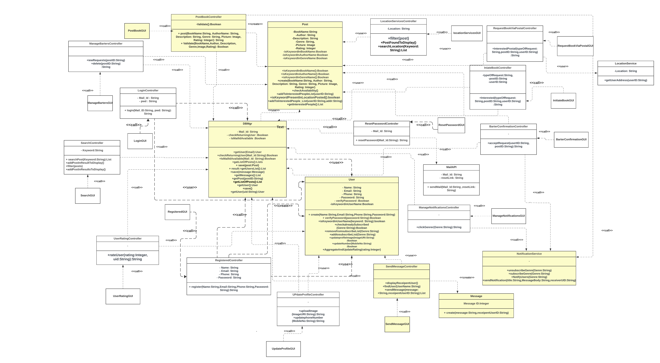

Slide 29
App Demo

Slide 30
Summary
Discussed the agenda & use cases corresponding to targeted requirements
Diligently considered and integrated the suggestions made in iteration 2
Focused on 2 EUCs (Post Book & Send Message for the Demo), 2 UC’s Sequence diagrams followed by DCD and used methods for quality management to test our code thoroughly

Slide 31


Slide 32

THANK YOU

